Slide 1
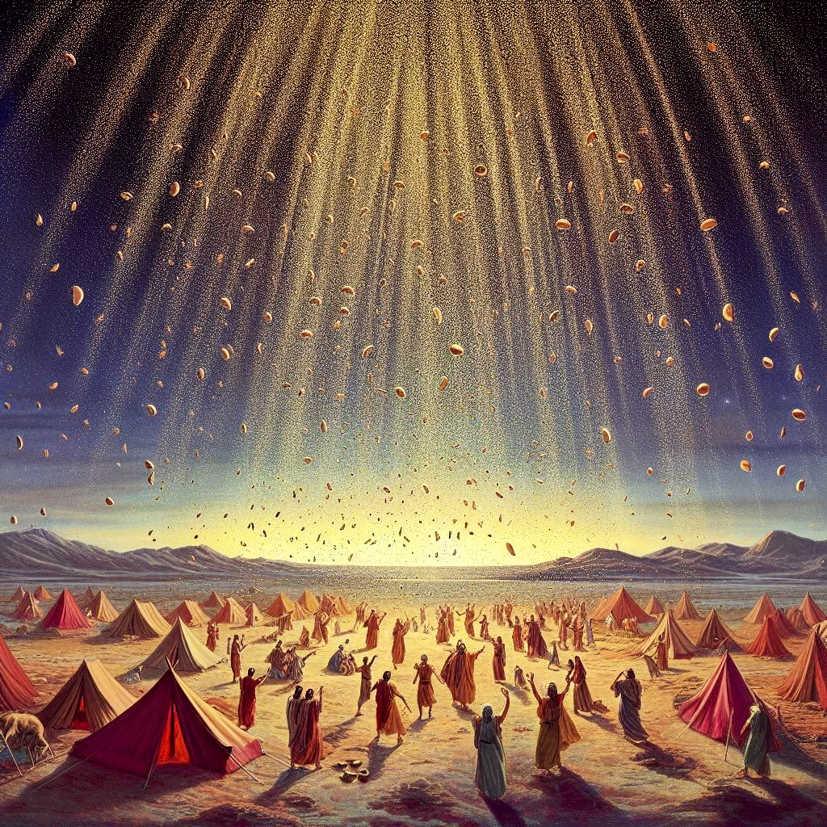
HIDDEN MANNA
Springs of Life-Giving Water Church
Pastor William Mathis, J.D., M. Div.

Slide 2
INTRODUCTION - HIDDEN MANNA (REVELATION 2:17)
BE ON ALERT FOR YOUR OPPORTUNITIES
An opportunity is a set of circumstances that makes something possible
1. Does this significantly contribute to the what should be for my life? If not, discard it if it takes you in the opposite direction or distracts you from what should be for your life. If it is neutral, regulate it to the routine. If it does significantly contribute,
2. Define how this connects to the circumstances that will advance you to the what should be for your life?

Slide 3
INTRODUCTION - HIDDEN MANNA (REVELATION 2:17)
BE DILIGENT IN ENGAGING YOUR POSSIBILITIES
Discover (find unexpectantly or in the course of a search) and Recover (find or regain possession of) your HIDDEN MANNA
1. What must I do intentionally to expose, educate, explore, and experience (in that order) to connect the dots of my possibilities to my circumstances? Journal throughout the process.
2. In the process, per my journal, what did I learn about God and myself, the real me?

Slide 4
INTRODUCTION - HIDDEN MANNA (REVELATION 2:17)
BE TRANSFORMED BY TURNING YOUR POSSIBILITIES INTO REALITIES
Your promise has been waiting on you to be who God created YOU to be
1. Specifically, identify who God created you to be.
2. Specifically, identify what prevents you from being who God created you to be. With these two things,
3. Apply Romans 12:1-2-MSG and discover and recover your HIDDEN MANNA, maturing you to His original intent in which He commands you to be fruitful, and multiply (be prosperous through His creation - including your life), to replenish (handle with care to ensure regeneration of His creation - including your life), and to subdue (cultivate His creation - including your life): have dominion (be responsible for His creation - including your life), per Genesis 1:27-28.

Slide 5
HIDDEN TREASURES
I. Light Shining In Darkness (II Corinthians 4:6-18-NIV)
A. Your Life Is Framed By The Word of God (John 1:1-5-MSG; Psalm
119:105; Romans 10:16-21; Hebrews 11:1-6)
B. Redeem The Times (Ephesians 5:8-16-MSG; John 8:12-NIV; I Peter
2:9-10-TPT; Matthew 26:41-NIV)
II. The More Revealed (Matthew 13:1-23-NIV)
A. Reaping The Harvest Of The More (John 4:34-38)

Slide 6
DIS-COVERING PROCESS
I. The Call To Prepare -“Dis”: A Reversing Force (Nehemiah 1-2-NIV)
A. Expose (Proverbs 30:5-NLT; Luke 8:16-18-NIV)
B. Educate (Proverbs 1:1-7-NIV; Proverbs 16:16-MSG; II Timothy 2:15)
C. Explore (I Thessalonians 5:19-22-MSG; I Corinthians 2:6-10-MSG)
D. Experience (Galatians 3:15-27-MSG)
II. The Glory of The Lord Shall Be Revealed (Isaiah 40:1-5-NIV)
A. The More: New Heaven and New Earth (Ephesians 3:20-21; Revelation 21:1-7)

Slide 7
RE-COVERING PROCESS
I. You Already Have It - “Re”: Again, Back (Genesis 1:26-31-NIV)
A. I Am That I Am Is With You (Exodus 3:10-14-NIV; Matthew 28:18-20)
B. The Lord Has Done Great Things (Joel 2:21-32-NIV; John 16:33-NIV)
C. Make Your Enemies Favorably Disposed Toward You (Exodus 3:21-22-NIV;
Psalm 23:5-6-NIV; Psalm 110:1-NIV)
II. Fearfully And Wonderfully Made (Psalm 139-NIV)
A. A Spring of Life (Isaiah 58:11-12-MSG)

